Slide 1



W-Secure

Slide 2


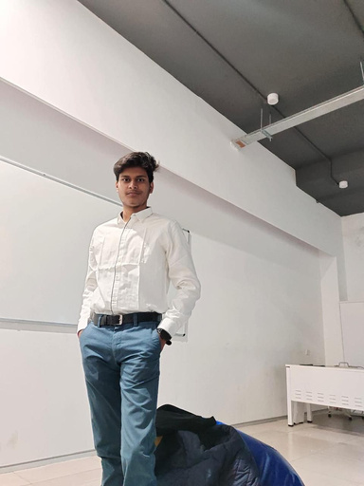

Team
1
Mayank Sharma E22CSEU0839
Shivansh Chauhan E22CSEU0814
Rakesh Sharma
E22CSEU0823
2
3

Slide 3
1
Problem Statement
Agenda
Project Overview
2
Topics Covered
3
About the Model
4
About App and Tech Stack
5
Limitations

Slide 4



Problem Statement
The increasing crimes against women in urban areas necessitate advanced surveillance solutions for real-time threat detection. Women Safety Analytics aims to address this issue by leveraging real-time monitoring and advanced analytics to create safer environments and assist law enforcement in crime prevention.

Slide 5



Project Overview
This project is a mix of two things, one is android app with security features like location sharing, helpline calling and video recording that'll be stored on the web so that it cannot be tampered (no redirection to the camera to maintain low profile during the whole recording). Marking of the Safe Spaces near the person and the features like SOS buttons that sends live locations to emergency contact.
Second being AI model that can be implemented in CCTV cameras to detect women in distress by analyzing the number to men following one women and by recognizing gestures(like hand raises).

Slide 6
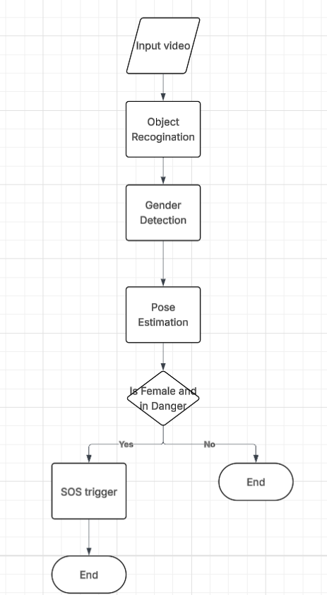
Our Model
Our project uses Yolo v8 for detecting people and then uses our AI model that is based on ResNet-50 architecture to detect whether the person is male or female. Then we use mediapipe to detect whether there is an emergency or not based on gesture recognition.
Our Project flow diagram
Go Back to Agenda Page

Slide 7


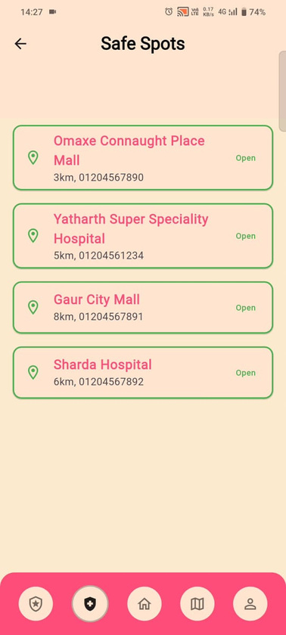
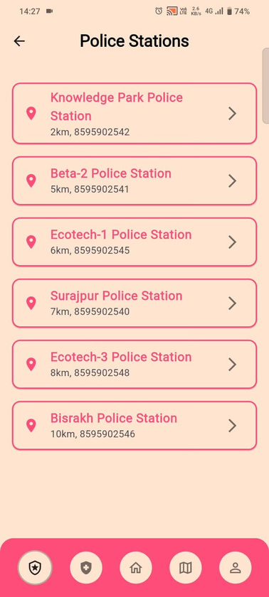
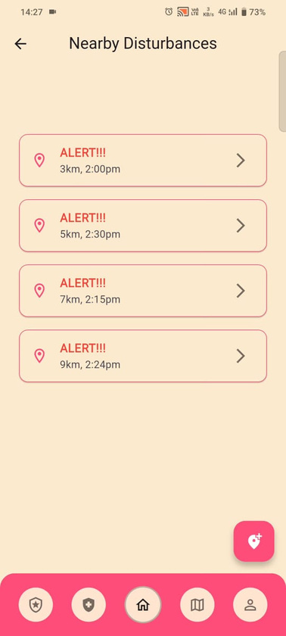
App Flow

Slide 8






Tech Stack and Tools

Slide 9
Limitations
Dataset Availability
Switch Off Hindering Functionality
Availability of Goggle Map API
Time Constraint

Slide 10




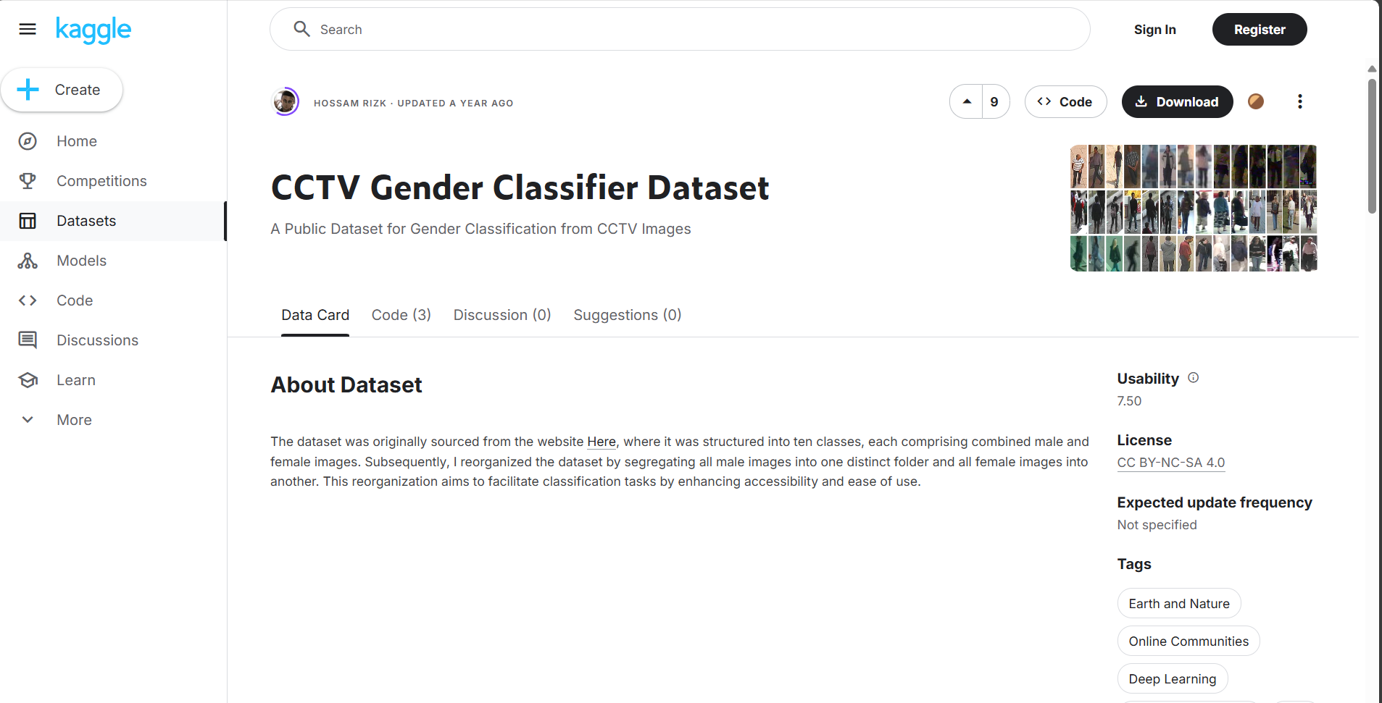





Our Dataset
https://www.kaggle.com/datasets/hossamrizk/cctv-gender-classifier-dataset

Slide 11










Resource
Page
https://www.sciencedirect.com/science/article/abs/pii/S003132030900079X#preview-section-cited-by
https://github.com/intel-iot-devkit/sample-videos
https://www.researchgate.net/profile/Faisal-Adhinata-2/publication/357756596_Gender_Classification_on_Video_Using_FaceNet_Algorithm_and_Supervised_Machine_Learning/links/61e162b48d338833e36b5cc6/Gender-Classification-on-Video-Using-FaceNet-Algorithm-and-Supervised-Machine-Learning.pdf
https://ieeexplore.ieee.org/abstract/document/10511733
https://ieeexplore.ieee.org/abstract/document/6737950

Slide 12
Thank you!

